Slide 1

Selenium Automation
Handling Pop ups in Selenium

Slide 2
Handling Popups:
In Selenium writing the code to handle the popup depends on the type of the pop up.
There are different types of popups in selenium based on their category they are as follows
Alert and Confirmation Popup
Hidden Division Popup
File upload Popup
File download Popup
Child browser Popup
Window Popup

Slide 3
1 Alert and Confirmation Popup and its Characteristics:
We can move the popup
We cannot inspect the popup
If the popup has the warning symbol with ok button then its called alert pop.
If the popup has the confirmation symbol with ok and cancel button then its called confirmation popup
They are also called JavaScript popup.
To handle the alert popup we need to transfer the control using switch to alert statement and then we use any of the following method of alert interface

Slide 4
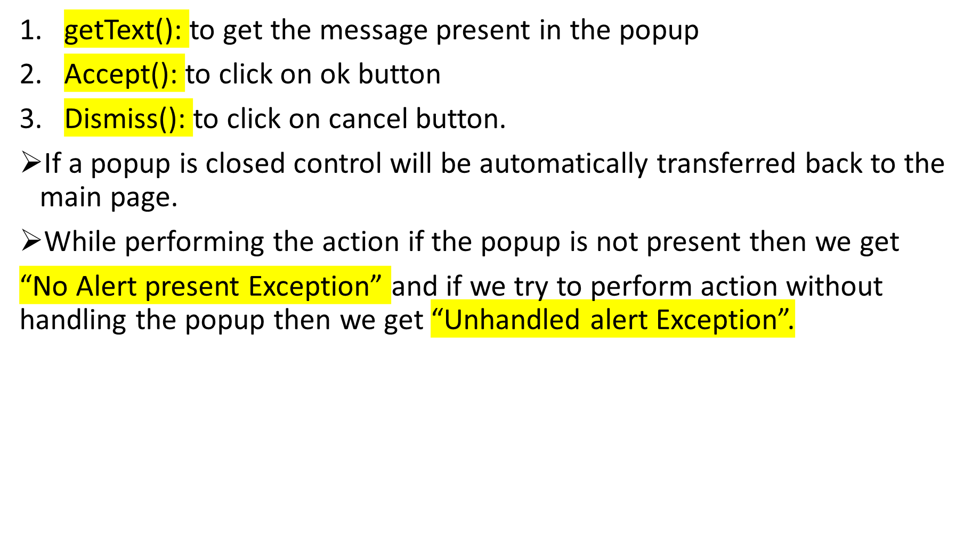
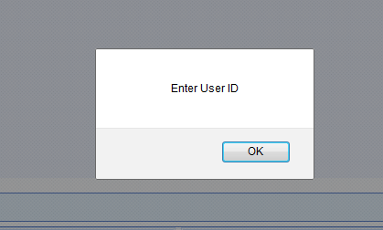

Slide 5
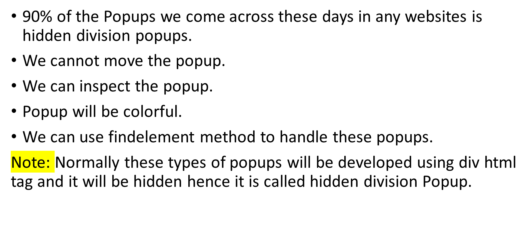
2 Hidden Division Popup and its Characteristics

Slide 6
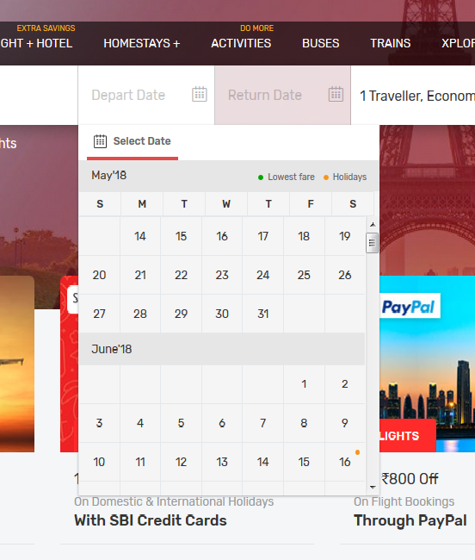

Slide 7
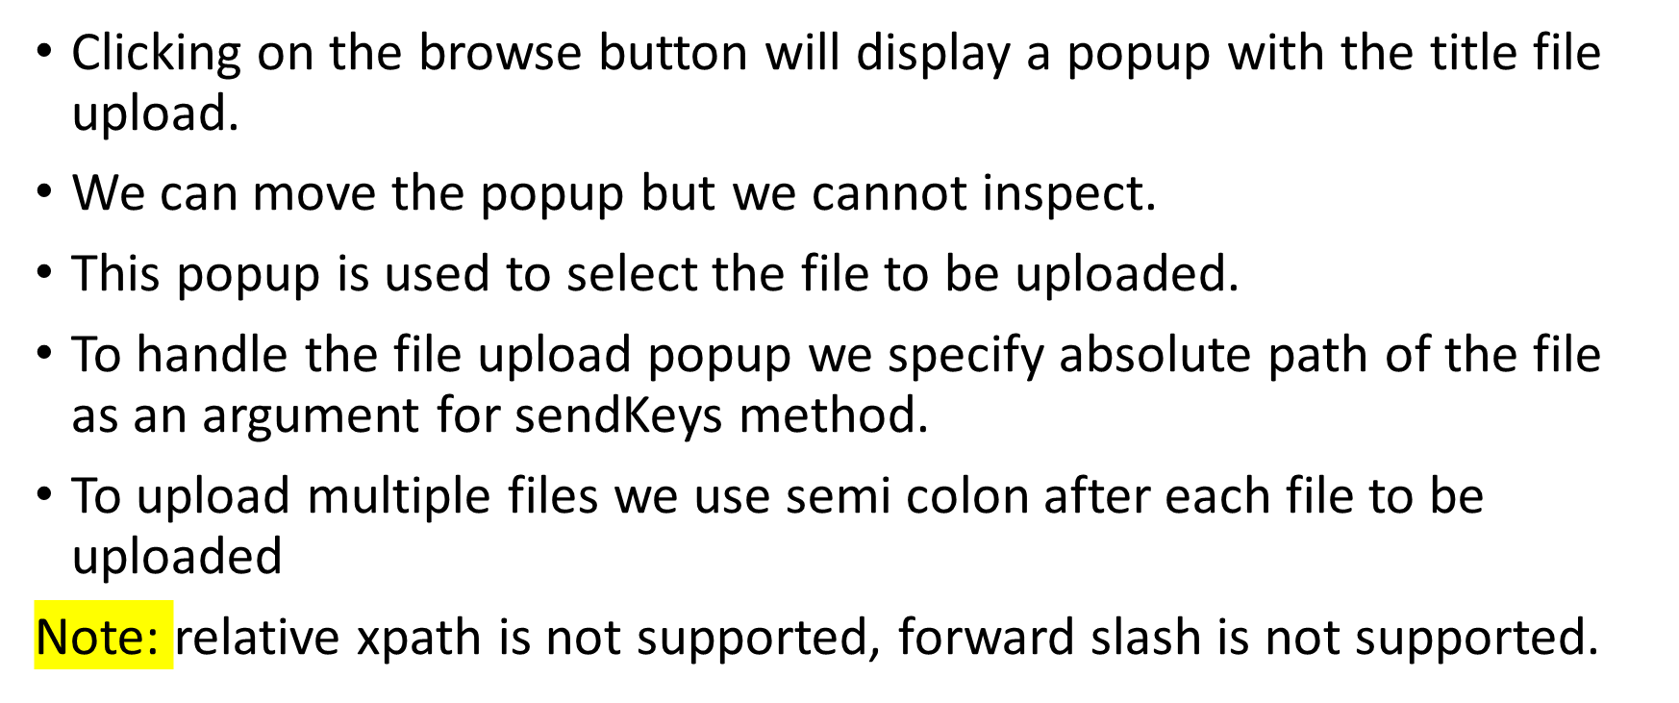
3 File upload Popup and its Characteristics

Slide 8
4 File download Popup and its Characteristics
We can move the popup.
We cannot inspect the popup.
It will have two options “Open with” and “Save”
We handle file down popup using set preference method of firefox class.
Other browsers we use a third party tool called AutoIT.

Slide 9
5 Child Browser Popup and its Characteristics
We can move the popup.
We can inspect the popup.
We can maximize the popup.
It will have the address bar.

Slide 10
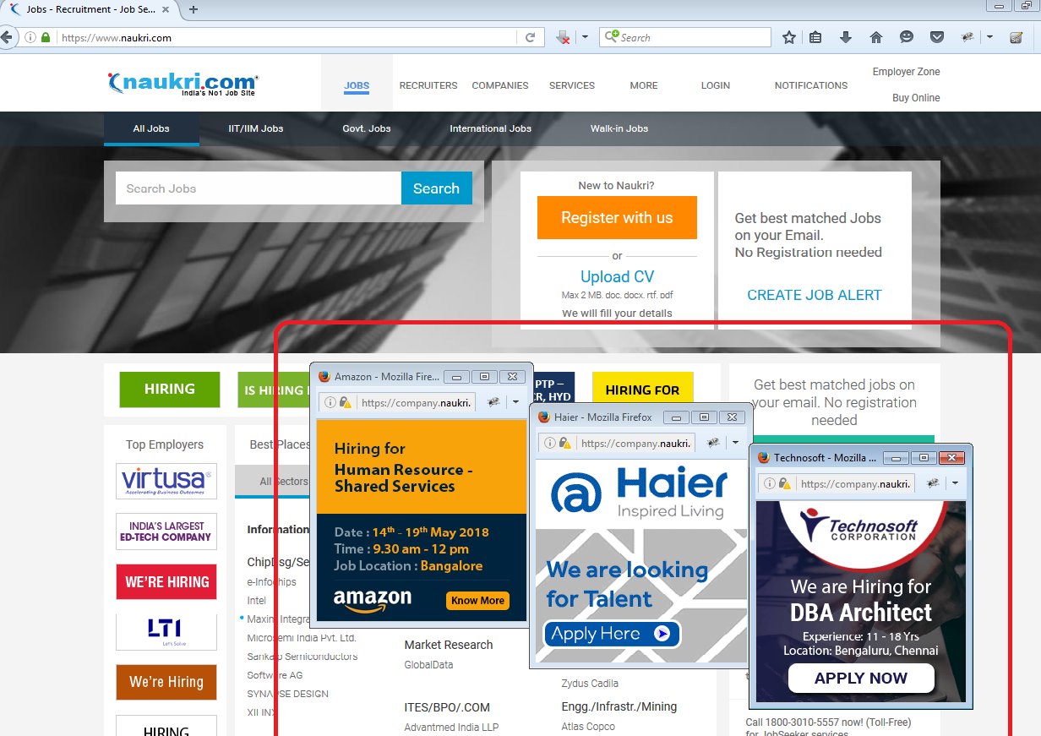

Slide 11
6 Window Popup and its Characteristics
If the popup displayed in the application is not from any of the above what we discussed then its known as windows popup.
Unfortunately selenium doesn’t support windows based application.
In order to handle this we use the third party tools like AutoIT, Winium, MonkeyRunner, Robotium or Sikuli etc.

Slide 12
